Slide 1
Azure Enterprise Governance & Security Designs-Focus on GC Federals
Mohamed Sharaf

Slide 2
READ THIS
This slide deck is *mainly* for:
Architects (Enterprise/Solution/ infra/ dev)
IT Admins
Developer leads
Has some benefit for
Managers / Directors
This slide deck is NOT
Executives
Sales or Marketing material
Operation manual for the *only* way to manage your Microsoft Cloud

Slide 3
Agenda
Subscription Design & management
Resource Groups
Access Control, Billing, and Usage
Subscription governance
Policies & Activity log alert

Slide 4
Subscription Design

Slide 5
Management Portals
Manage access
Manage accounts
Manage subscriptions
View price sheet
View usage summary
Manage usage & lifecycle email notifications
Manage Authentication Types
Account Portal (https://account.windowsazure.com
Enterprise Portal (https://ea.azure.com/
Edit subscription details
Enroll in or enable Preview features
Management Portal (https://manage.windowsazure.com or https://portal.azure.com
Manage co-administrators on subscriptions
Open support tickets for issues within the subscription
Provision/de-provision Azure services
Manage Market place access
Manage Subscriptions (change ownership)

Slide 6

Enterprise Azure Roles and Portals
https://ea.windowsazure.com
Enterprise Administrator
Enterprise Enrollment
Department Administrator
Department
Department
https://account.windowsazure.com
Account Owner
Account
Account
Account
https://portal.azure.com
Service Administrator
Subscription
Subscription
Subscription
Subscription
Notes:
To administer your Microsoft Azure services under your Enrollment, there are three distinct administrative roles: the Enterprise Administrator, the Account Owner and the Service Administrator. Users are required to authenticate using a valid Microsoft Account (LiveID http://signup.live.com) or Organizational Account (Cloud-based Active Directory). Make sure the ID entered is associated with a monitored mailbox as enrollment and account notifications will be sent to this mailbox.
The roles complete tasks on three different Microsoft Azure portals. The Enterprise Portal, the Account Portal and the Management Portal.
Enterprise Administrator The Enterprise Administrator has the ability to add or associate Accounts to the Enrollment, can view usage and charges data across all Accounts and Subscriptions, can view the monetary commitment balance associated to the Enrollment. There is no limit to the number of Enterprise Administrators on an Enrollment. You can also add a Notifications Contact that can receive all email notifications. The EA portal is all about billing and usage, enabling the Enterprise Administrator to view billing and usage across all accounts.
Account Owner The Account Owner can add Subscriptions for their Account, update the Service Administrator and Co-Administrator for an individual Subscription, view usage data for their Account, and view Account charges if the Enterprise Administrator has provided access. The Account Owner will not have visibility of the monetary commitment balance unless they also have Enterprise Administrator rights.
Service Administrator The Service Administrator and Co-Administrators per Subscription have the ability to access and manage Subscriptions and development projects within the Azure Management Portal. The Service Administrator does not have access to the Enterprise Portal unless they also have one of the other two roles.

Slide 7
What is an Azure Subscription?
Governs the following:
Billing relationship (billing APIs supports now EE level)
Account administration
Role Based Access Control (RBAC) to artifacts
Boundaries/Limits
Boundaries
Limits
Virtual Network
Attached to 1 AAD (1 AAD be associated with many subscriptions)
Associated to an enterprise enrollment account
Notes:
See https://azure.microsoft.com/en-us/support/legal/offer-details/ for offer codes

Slide 8
Enterprise Dev/Test subscription
Done by marking the account as Dev/Test
Even Better rates for VMs, HDInsight, Cloud Services, and Websites because there’s no license cost
All usage consumes Azure Monetary Commitment funds
Exclusive Gallery images, like Windows 7 / 8.x / 10 client
Dev/test use only and no SLA
Should be created by a user who has msdn subscription
Can convert a normal subscription to Dev/test subscription

Slide 9
Subscription Considerations
Management approach
Single team or cross-organizational
Role Based Access Control (RBAC)
Security requirements
Data or network security
Environments - Sandbox, Dev, Test, UAT, Pre-Prod, Prod
Connectivity requirements
Single point of ingress?
Multiple regions?
Application requirements
Compliance

Slide 10
Subscription Limits
Default limits are soft-limits as safety for the customer
Change them from the portal (Subscriptions → Usage + quotas)
Fill the form and will increase immediately
Notes:
Updated 06/03/2016
This slide is an eye chart, but it tells an important story: subscriptions have limits. You cannot simply create a single subscription, you need to design according to limits. These limits also differ if you are using the old Azure Management Portal, which uses the Service Management API, or the new portal, which uses the Azure Resource Manager API.
Format is Default/Maximum so 20/200 = 20 default, 200 maximum
aka.ms/azurelimits

Slide 11
Subscription Limits (subset)
Azure Resource | Resource Manager API (Default limit/Maximum limit)
VMs per subscription | 10,000/10,000 per region
Cores per subscription | 20/10,000 per region
Storage accounts per subscription | 100/250 (support approval required)
Managed Disks | 10,000 per subscription per storage type
Virtual networks per subscription | 50/1000
Local networks per subscription | 10/500
Network Security Groups | 100/5000
Public IP addresses (dynamic) | 60/Contact Support
Reserved public IP addresses | 20/Contact support
Resource Groups per subscription | 800/800
https://azure.microsoft.com/en-us/documentation/articles/azure-subscription-service-limits
Notes:
Updated 31/10/2017
This slide is an eye chart, but it tells an important story: subscriptions have limits. You cannot simply create a single subscription, you need to design according to limits. These limits also differ if you are using the old Azure Management Portal, which uses the Service Management API, or the new portal, which uses the Azure Resource Manager API.
Format is Default/Maximum so 20/200 = 20 default, 200 maximum
aka.ms/azurelimits

Slide 12
Suggested subscription topology
EE
Central IT Department
Central IT Prod
Dev/Test Subscription
Business Unit 01
BU01 Acct
BU01 Subscription
Business Unit 02
BU02 Acct
BU02 Subscription
Central IT Dev/Test
Central IT Subscription

Slide 13
Subscription Management

Slide 14
How do I manage an Azure Subscription?
Service Manager Roles
Account administrator (create, cancel, billing)
Service administrator (Same as account admin)
Co-Administrator (Can’t change Azure AD, billing, create, etc.)
Account types
Personal (Microsoft Accounts)
Organizational Accounts (Azure AD)
As a Partner
Partner manages (On behalf of)
Resource Manager Roles
Role based access via assignment
Add Partner’s accounts as guest accounts

Slide 15
How do I mange someone else's subscription?
ARM
Transfer
Add as a co-owner
User Id/app Id in subscription (service administrator)
User id/app Id in resource group
Notes:
https://azure.microsoft.com/en-us/documentation/articles/billing-subscription-transfer/

Slide 16
Subscriptions operations
Each subscription trusts only one Azure AD
Subscriptions in the same Enterprise Enrollment can trust different AD
Change the AD trust
Cancel subscription
Data is retained for 90 days before it’s permanently deleted. Contact support for
Subscriptions can be reactivated during these 90 days and data is restored

Slide 17
Resource Groups
Logical group for Azure resources
Azure portal (portal.azure.com) can only work with Azure Resource Manager APIs
Any resource has to have a resource group
You can deploy and manage resources as one group
Can deploy using programing syntax or declarative syntax

Slide 18
Manage subscriptions using Portal , PowerShell & Azure CLI
Notes:
List subscriptions and select them

Slide 19
Access Control, Billing, and Usage

Slide 20
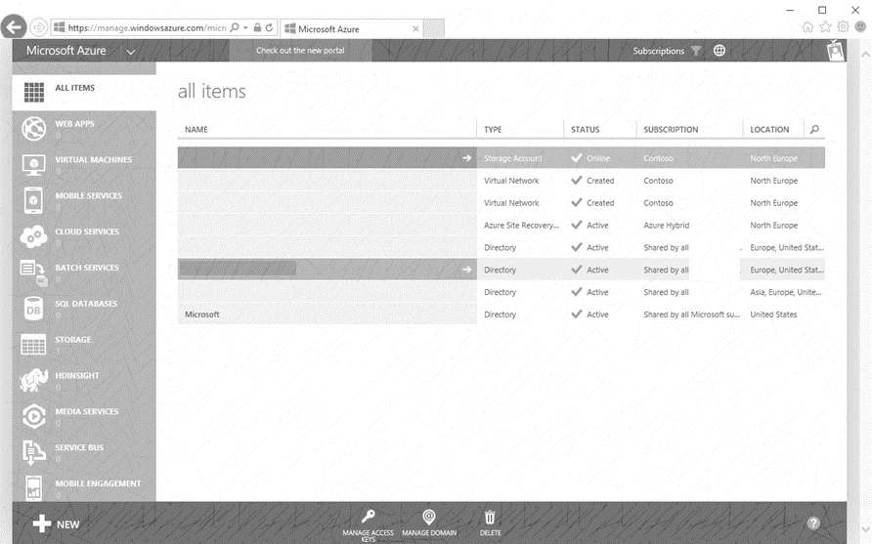
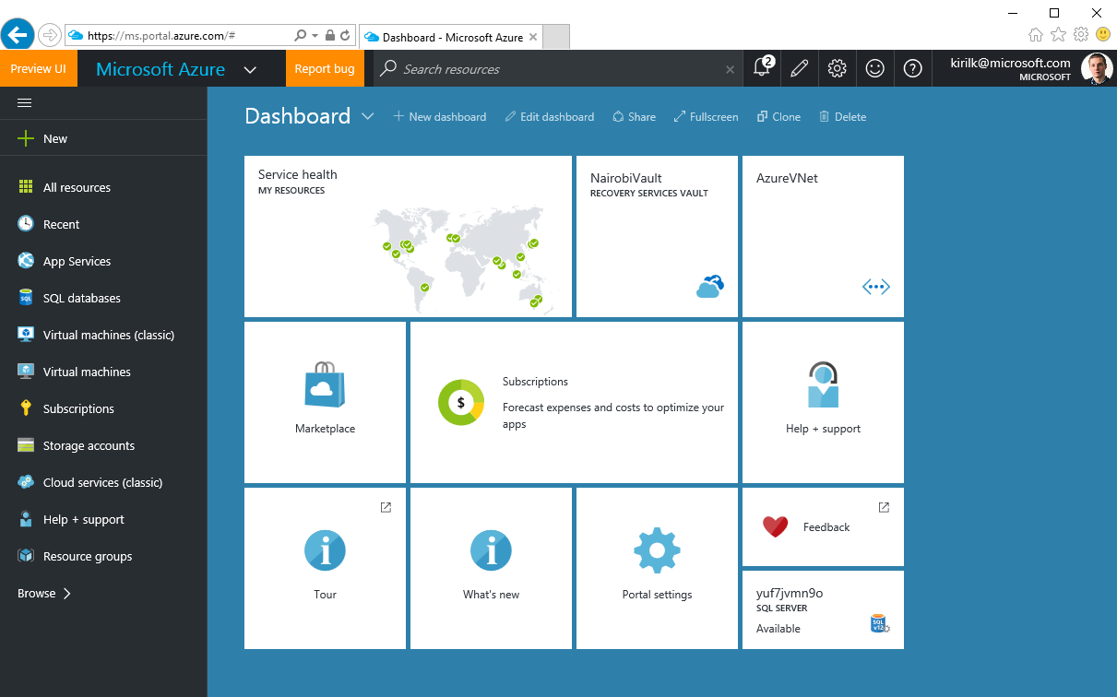
2 generations of Azure
Azure Service Management (ASM)
Azure Resource Manager (ARM)
https://manage.windowsazure.com
No Role Based Access Control
Not available in CSP
https://portal.azure.com
Resource Groups & Tags
Role Based Access Control

Slide 21
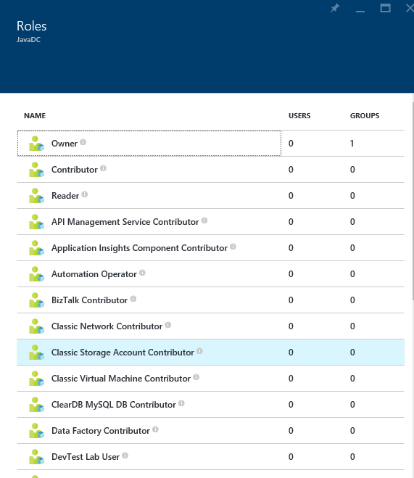
Role Based Access Control (RBAC)
Allows secure access with granular permissions
Assignable to users, groups, or service principals
Built-in roles make it easy to get started
NOTE – RBAC in ARM applies to resources exposed via ARM. Software inside of VMs which may have it’s own security mechanisms and should be considered during design.
Notes:
ARM provides role-based access control, integrating with the Azure Active Directory directory associated with your subscription. This allows you to limit access to resource groups or resources to specific users or groups. There are built-in roles, such as “Virtual Machine Contributor” that lets you manage virtual machines, but not the access to them, and not the virtual networks or storage they are connected to.
It’s important to note RBAC in ARM applies to resources exposed via ARM. Software inside of VMs which may have it’s own security mechanisms and should be considered during design.

Slide 22
Role Based Access Control (RBAC)
Notes:
Access is inherited in the RBAC model. Contributors, owners, and readers assigned at the subscription level have access to the resource groups and resources within that subscription. This can be useful when monitoring all resources deployed to a subscription.
A user assigned as a contributor, owner, or reader of a resource group has access to that resource group and everything contained within it. This can be useful when monitoring a group of resources that comprise an application.
Users and roles can be assigned at the resource level. You might assign a reader for a specific resource so they can see, but not modify, a resource. This can be useful when monitoring a specific resource.

Slide 23
Role Based Access Control (RBAC)
Can get the effective permissions per Subscription, Resource Group or resource
Can get effective permissions per user
Using portal, PS or Azure CLI
68 built-in roles *
All RBAC assignments are tracked in Azure Activity Log
Notes:
* October 2017

Slide 24
Custom RBAC
Custom roles if the built-in roles are not appropriate
Can be created by PS, CLI or REST API
Can create up to 2000 custom roles per tenant
Can assign operations or exclude operations
Excluded operations are not denying the action.
Assignable scope control to which level or specific subscription/resource group the role can be applied

Slide 25
Custom RBAC
Get-AzureRmProviderOperation shows the operations of Azure Resource Providers
Get-AzureRmRoleDefinition shows the builtin or custom roles definitions
Export a built-in role and then customize it.
New-AzureRmRoleDefinition –InputFile <file>

Slide 26
Mapping teams to RBAC - examples
Teams | Built-in Role | Custom Role
Storage Administrator | Storage Account Contributor
Network Operator |  | Network Contributor - permissions
Network Engineer | Network Contributor
Platform Operator |  | Virtual Machine Contributor - permission
Platform Engineer | Virtual Machine Contributor
Security Engineer |  | Security Admin + Security Manager

Slide 27
RBAC
Notes:
List subscriptions and select them

Slide 28
Resource Tags
Name-value pairs assigned to resources or resource groups
Subscription-wide
Each resource can have up to 15 tags
Name <=512 | Value <=256
No inheritance
Not for Classic (ASM resources)
x15
Notes:
Tags can be applied to resource groups or individual resources, and these tags appear within your usage and billing statement. This enables you to track consumption against individual IO codes, projects, or other taxonomies. You can apply up to 15 tags per resource and resource group. Tags may be placed on a resource at the time of creation or added to an existing resource.

Slide 29
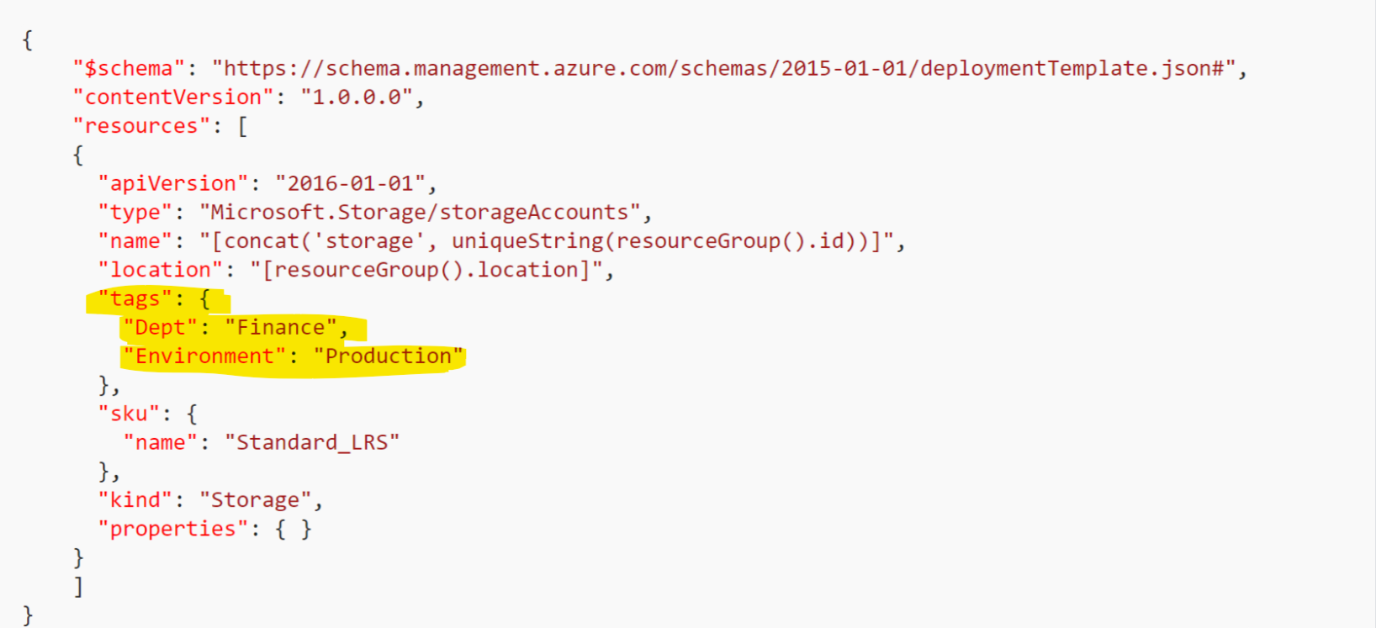
Resource Tags
Tags can by applied in ARM templates, PowerShell, Azure CLI but NOT in the creation wizard in the portal

Slide 30
Tagging Tips
Tag by environment, e.g. dev/test/prod
Tag by role, e.g. web/cache/db
Tag by department, e.g. finance/retail/legal
Tag by responsible party, e.g. Bob
From EA portal, you can get billing excel sheets with the
x15

Slide 31
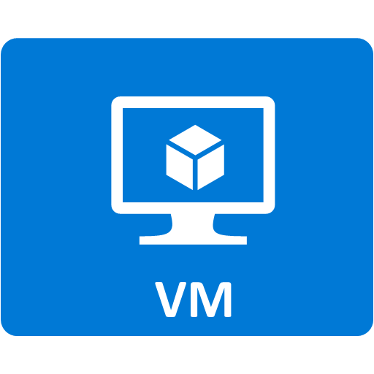
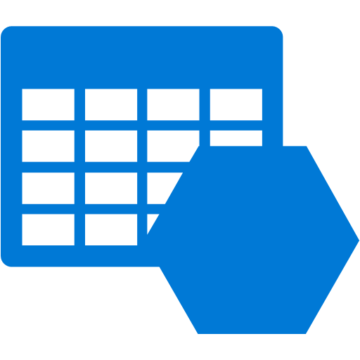


Demo Architecture
Resource Group
IO Code
Virtual Machine Contributor
Availability Set
Machine Type
Machine Type
VM0
VM1
Storage
Virtual Network
Network interface
Network interface
Load balancer
Notes:
The previous demonstration showed how to use a template to provision resources to a resource group. This demonstration will show how to apply tags and role-based access control. We will apply a custom tag, “IO Code”, to the resource group, apply a custom tag “Machine Type” to the virtual machines, and assign the group role “Virtual Machine Contributor” to the resource group.

Slide 32
Billing APIs
Balance and Summary (monthly)
Usage Details (daily, export to CSV)
Marketplace Store Charge
Price Sheet
Billing Periods
Notes:
https://docs.microsoft.com/en-us/rest/api/billing/enterprise/billing-enterprise-api-balance-summary
https://docs.microsoft.com/en-us/rest/api/billing/enterprise/billing-enterprise-api-usage-detail
https://docs.microsoft.com/en-us/rest/api/billing/enterprise/billing-enterprise-api-marketplace-storecharge
https://docs.microsoft.com/en-us/rest/api/billing/enterprise/billing-enterprise-api-pricesheet
https://docs.microsoft.com/en-us/rest/api/billing/enterprise/billing-enterprise-api-billing-periods

Slide 33
Azure Cost Management
Former Cloudyn offering
Free for enterprise customers till June 2018
Notes:
https://azure.microsoft.com/en-ca/services/cost-management/

Slide 34
RBAC and Tagging
Notes:
Find-AzureRmResource -TagName "alwayson"

Slide 35
Azure Resource Manager Policies
Establish conventions
Policy definition
parameters
display name
description
policy rule
logical evaluation
Effect
Policy assignment
Subscription
Resource Group

Slide 36
Azure Resource Manager Policies: Scenarios
Chargeback: Require departmental tags
Geo Compliance: Ensure resource locations
Service Catalogue: Select your service catalog
Convention: Enforce naming & tags
Combine ARM Policies with Activity Log Alerts to cover all requirements

Slide 37
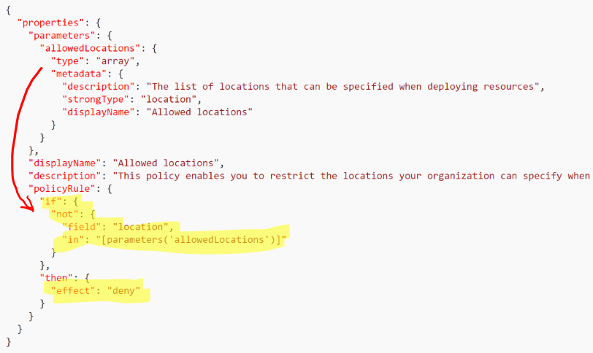
Azure Resource Manager Polices-examples

Slide 38
ARM policies
Notes:
Find-AzureRmResource -TagName "alwayson"

Slide 39
Azure Monitor

Slide 40
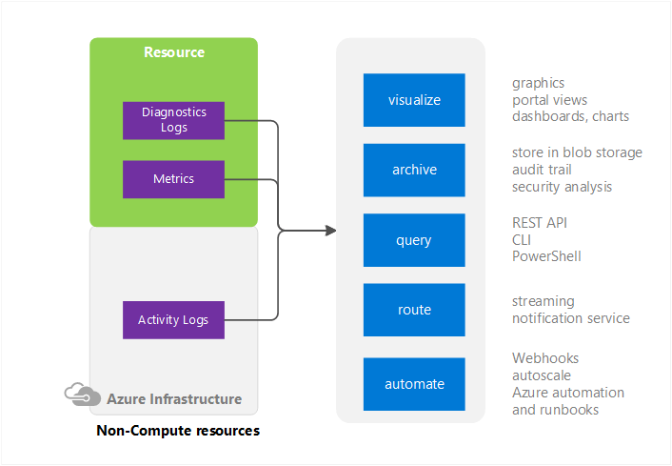
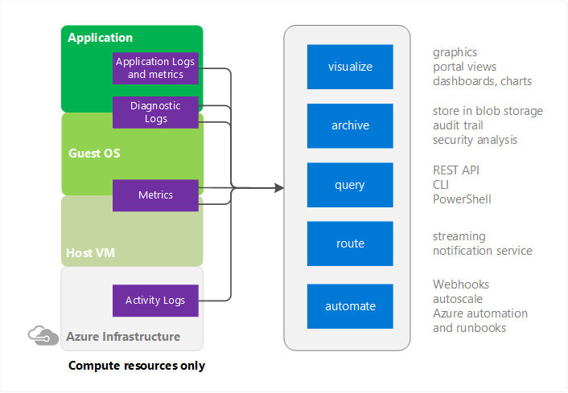
Azure Monitor
One stop built-in monitoring for Azure on multiple levels
Doesn’t use a separate agent

Slide 41
Azure Monitor
Has many sources
Activity log
Diagnostics logs, Application logs and Matrices
Performance counters
Application Logs
Windows Event Logs
.NET Event Source
IIS Logs
Manifest based ETW
Crash Dumps
Customer Error Logs
Integrate with Log Analytics, Event Hubs & storage accounts

Slide 42
Azure Monitor
Can create alerts based on matrices or Activity Log
Alerts delver immediate SMS/email or webhook
Activity log alerts use cases
When creating certain type of resoruces
When Altering the state of important resources
When important resource restarts or change its operation state
When permissions are granted to users/groups

Slide 43
Naming Conventions in Azure

Slide 44
Naming Conventions
Importance
Places the naming pattern in an order that allows easier application level grouping for potential showback/chargeback billing.
Automation.
Consideration
Some resource names are:
Requirements
Ensure:
Constrained by length.
Constrained to alpha-numeric.
Constrained unique within account
Cannot contain offensive or forbidden substrings.
Case sensitivity requirements
Application association
Environment association
Region association
Instance association
Object association
Describes type of resource in the subscription.
Unique Azure naming
Constrained unique across entire Azure.
Cannot include upper case characters.

Slide 45
Azure Naming Constraints Examples
Some resource names are constrained-Must be globally unique across Azure
e.g., SQL Server Name, Storage Account Names, etc.
Some resource names are constrained by length
e.g., Search Service is constrained 2 to 15 characters
Some resource names are constrained to alpha-numeric
e.g., Storage Account Name cannot have dash, dots, etc.
Some resource names must be unique within the subscription
e.g., Storage Table Name must be unique within Azure storage account
Some resource names cannot be upper characters
e.g., Storage account names must be all lower case

Slide 46
Subscription Governance summary

Slide 47
Subscription Design Guidance (General)
Work or School Accounts not Microsoft Accounts
Use organizational accounts to sign-up and manage Azure. Connect your Azure AD with on-prem AD.
Resource Groups not Subscriptions
Use resource groups to segregate workloads with different access needs. Avoid granting access to individual resources unless necessary.
Manage Access using Groups
Assign access to AD groups, manage membership of groups for on-going access management.
Enable Multi-Factor Auth
Use Azure AD conditional access policies to enable MFA for Azure management.
Least Privilege
Pick the right role for the job. Contributor not Owner. Model on-premises roles using resource-type specific Azure roles.

Slide 48
Subscription Design Guidance (General)
Keep a tab on Access Changes
Monitor changes to access settings. Regularly dump and review entire access policy.
Control # of subscriptions. Start with 3 (1 Business Unite/function, 1 IT, 1 Dev)
Identity Management
Use Customer Azure Active Directory for Azure Governance roles
Add at least one more Enterprise Administrator
Use Functional Accounts not Named Accounts for Roles. Specially for Account Owners and Service Administrators
Security and Identity
If the subscription includes Azure Active Directory, IaaS Domain Controllers, or connects to Domain Controllers from an on-premises active directory, the Subscription administrators and Co-administrators are de-facto domain owners as well.
Scale
Subscriptions form the scale unit in Azure. Many resources, from computing cores, and storage accounts, to reserved IP addresses all have quantity and size limitations based on the subscription.

Slide 49
Subscription Design Guidance (Networking)
Connectivity
The subscription is a required container to hold a virtual network, and oftentimes networking is a shared resource within an enterprise
VLANs do NOT span subscriptions
Express Route
Minimize #subscriptions (take network requirements and ER boundaries into account)
10 virtual networks can be attached to a single ExpressRoute standard circuit, so at most 10 subscriptions could be attached to that circuit (Premium varies from 20-100)
Notes:
https://azure.microsoft.com/en-us/documentation/articles/azure-subscription-service-limits/#limits-and-the-azure-resource-manager

Slide 50
Resources
Design for subscription boundaries
Billing and Usage APIs
Azure Resource Manager provides RBAC, tagging, organization, and deployment
Samples - https://github.com/Azure/azure-quickstart-templates
Documentation - http://azure.microsoft.com/en-us/documentation/articles/resource-group-overview/

Slide 51
Resources
Best practices for enterprises moving to Azure | Microsoft Docs
https://docs.microsoft.com/en-us/azure/azure-resource-manager/resource-manager-subscription-governance

